Slide 1
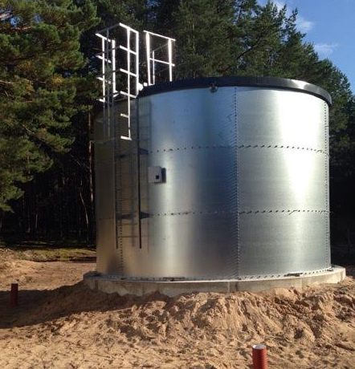

Fire Protection
Personal, Commercial, Industrial, & Municipal Systems
Official Representative for Climate Fire Suppression Tanks

Slide 2
Why own a fire suppression tank system?
It is guaranteed that your internal fire sprinkler system will operate, even if the city water system fails
You can add external fire sprinklers to your home or building
The fire department can connect to your fire suppression tank and save your home or building, even if the local fire hydrant is not operating
You can have a pump and hose system attached to the tank, so you can be your own fire department (last resort)
Reduce insurance costs
Systems can be designed for one home, or for a group of homes / subdivision

Slide 3
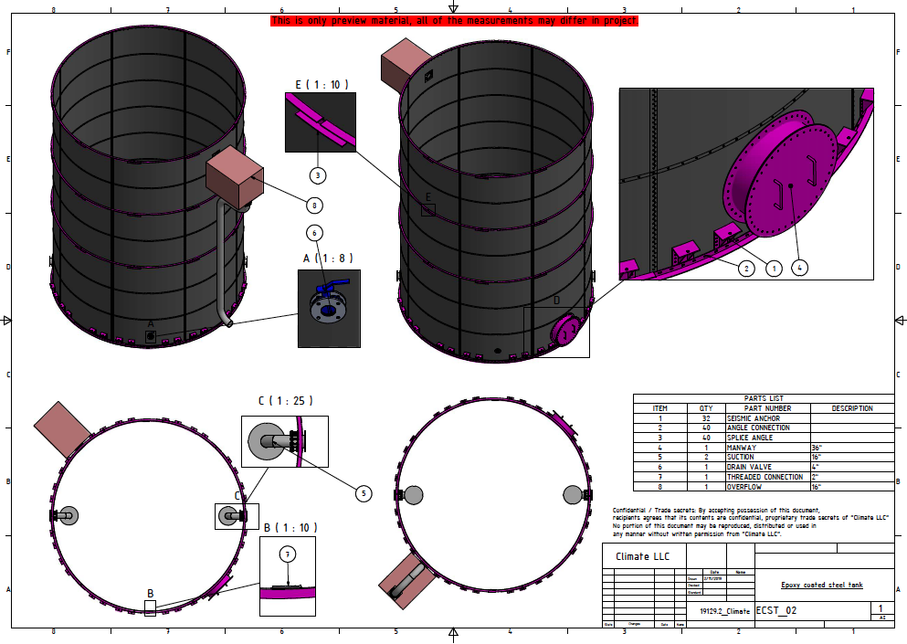
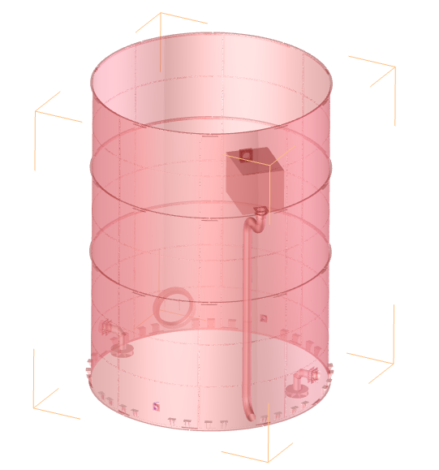
Introducing: Climate, Incorporated Engineered Solutions:

Slide 4
Leading the way globally:
Climate, Incorporated supplies tanks and accessories to over 37 countries around the globe.
We started our business in 1997 in Atlanta, Georgia and have sold thousands of tanks globally.
Our manufacturing facility uses state of the art equipment and exceeds all industry standards.
Climate manufactures steel bolted tanks: stainless steel, glass fused to steel, epoxy, weathered finish, powder coated, and galvanized, and we are the only steel bolted manufacturer to have all six types under one roof of production.
We provide our services to certified installation crews, licensed general contractors, architects, and engineers: tanks, components, and accessories.
Our tanks, components, and accessories exceed all National and International Standards:
AWWA: American Water Works Association-governing body in North America for tank standards.
NFPA: National Fire Protection Agency-governing body in North America for fire water tanks.
EU: European Union-governing body in Europe and Asia for tank standards.
TCEQ: Texas Commission on Environmental Quality-environmental agency for the state of Texas.
FM Approvals: Third party global testing laboratory and certification agency.
OSHA: Occupational Safety and Health Administration-Agency of US Department of Labor which provides Laws and Regulations for Safety

Slide 5
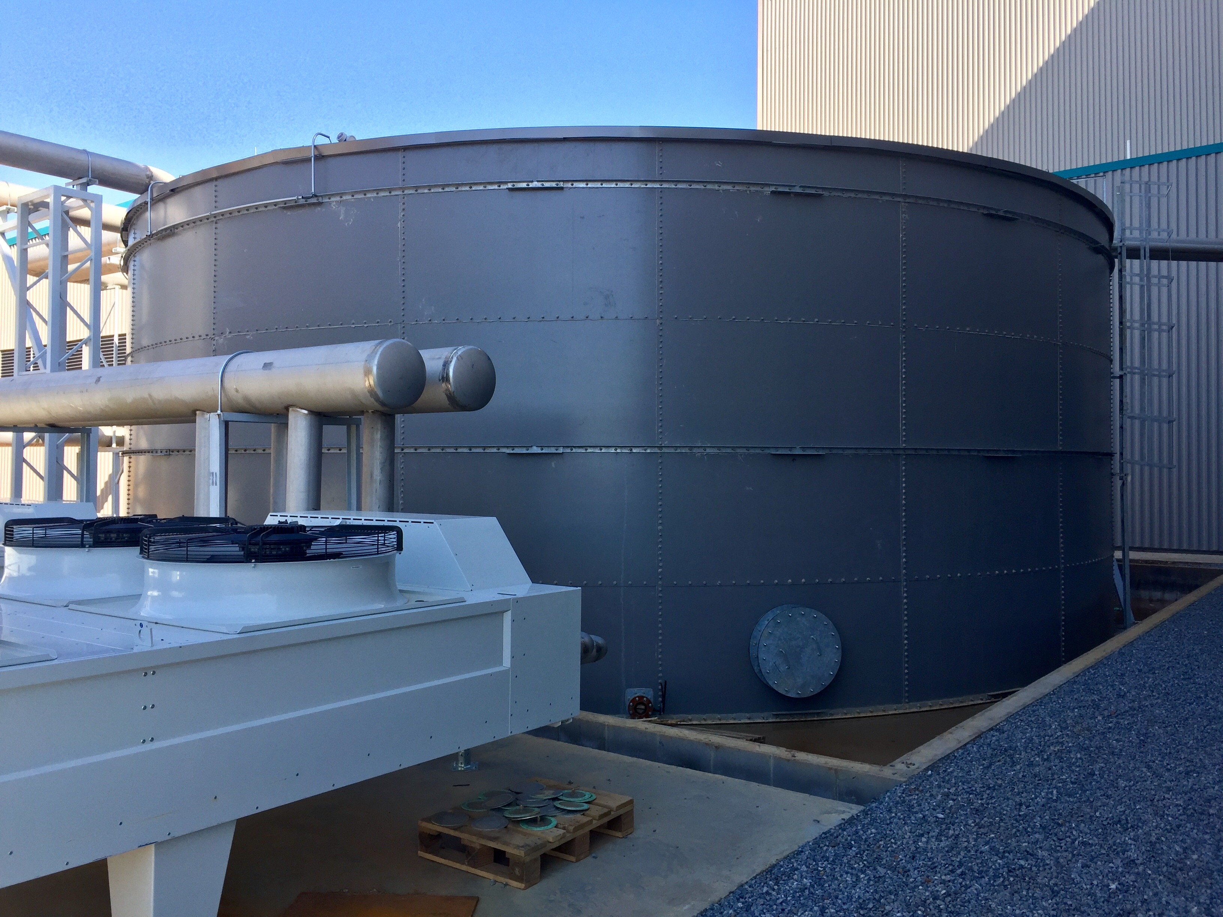
About Climate:
Climate is a manufacturer of stainless steel, glass fused to steel, epoxy and powder coated, weathered finished, as well as, galvanized steel bolted tanks. We are a global company in which focus on these areas, but are not limited to:
Biomass Energy Projects:
-Anaerobic Digester tank
-Biofuel (Ethanol or Alcohol or Biodiesel0
Water treatment industry:
-Municipal project-Potable Water tank, sewage tank
-Industrial waste water treatment
-Sea water cleaning treatment
- Leachate water tank
-Other water treatment
Agriculture:
-Irrigation project
-Irrigation water tank
-Slurry; farm pollution
Petrochemical Industry:
-Petrochemical liquid tank
Power Generation:
-Cooling water tank
-Leachate liquid tank
Food Industry:
-Edible Liquid tank (Beer, soy, vinegar, etc)
Dry Bulk:
-Grain storage silos
Mining:
-Treatment tanks
-Bulk storage
-Processing
-Effluent
Rainwater and Stormwater Harvesting:
-Residential
-Commercial
-Industrial
Fire Protection:
-Fire water tank
Industrial Liquid Projects:
-Rainwater Harvesting
-Industrial liquid tank
-Effluent
-Process water

Slide 6
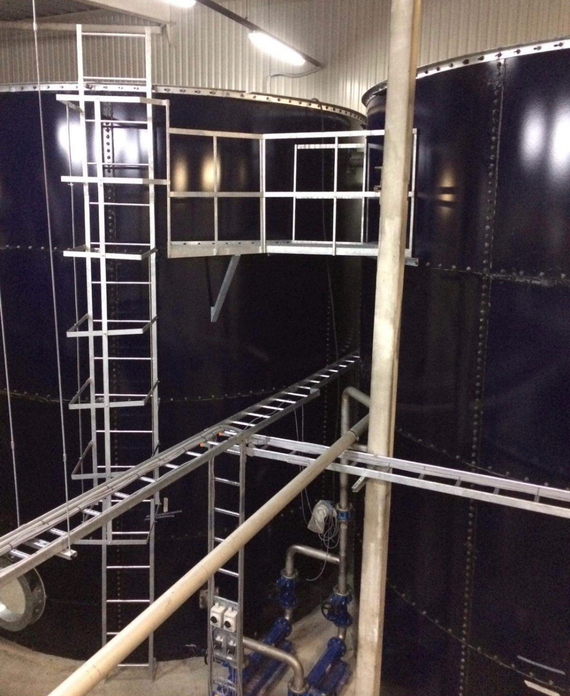
NFPA & awwa Standards:
Sufficient capacity to sustain the designed fire protection demand: Engineered Solutions
Water level monitoring method to advise if tank is not at required capacity: Manual Tank Level Gauge
System with dual access entry: Engineered Solutions
Insulation and/ or water heating method to prevent water from freezing: Insulation Package & Immersion Heater
System that exceeds American Water Works Association Standards (AWWA): Engineered Solutions
Anti-vortex features to prevent a whirlpool effect from occurring in the tank suction or gravity outlet: Vortex Inhibitor
OSHA compliant exterior ladders including safety cages and railings: Engineered Solutions

Slide 7
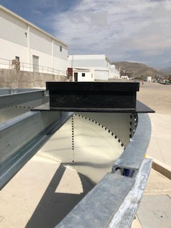
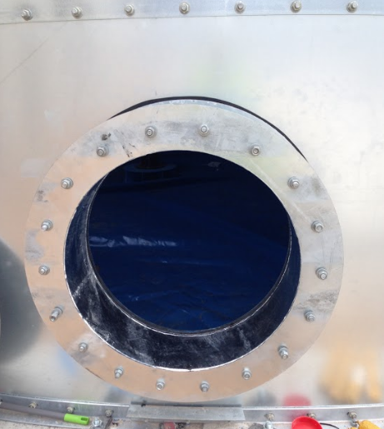
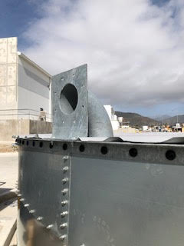
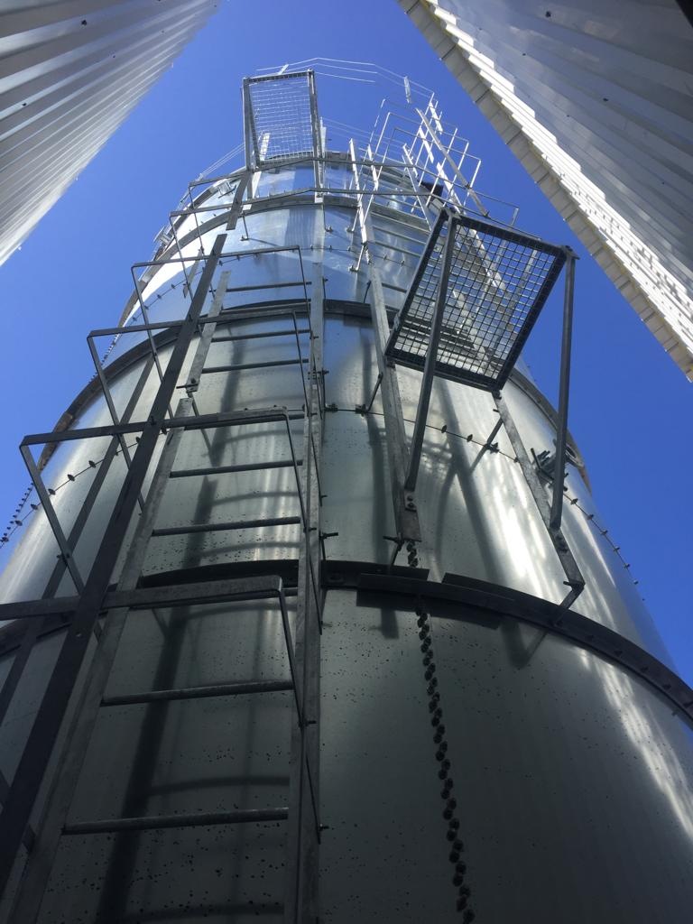
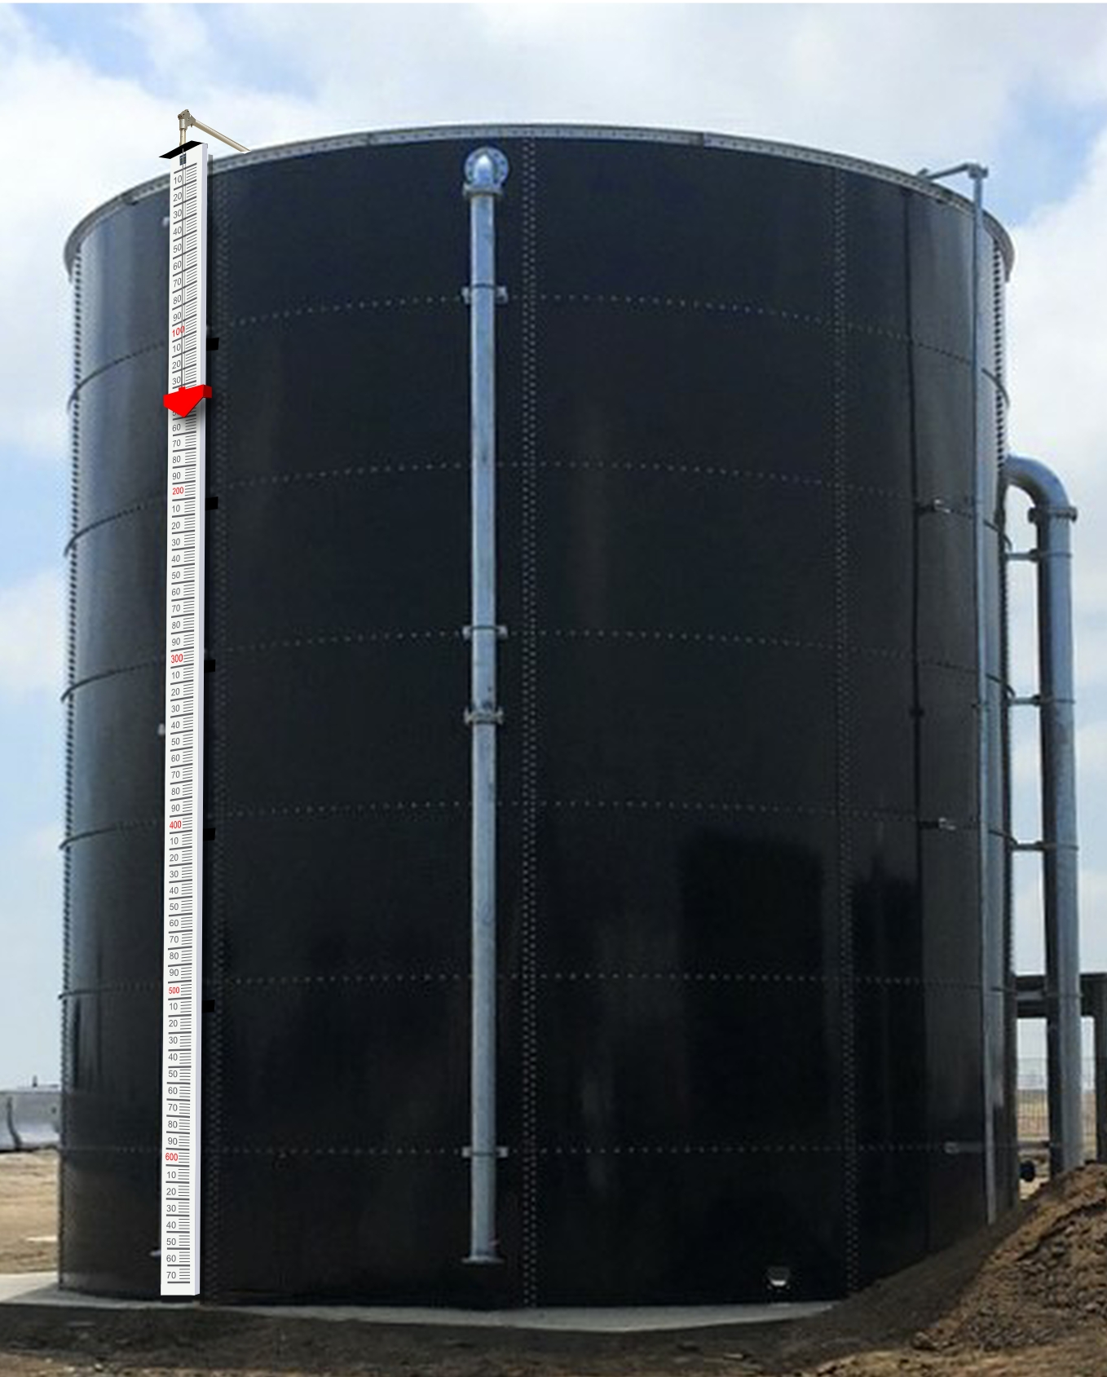
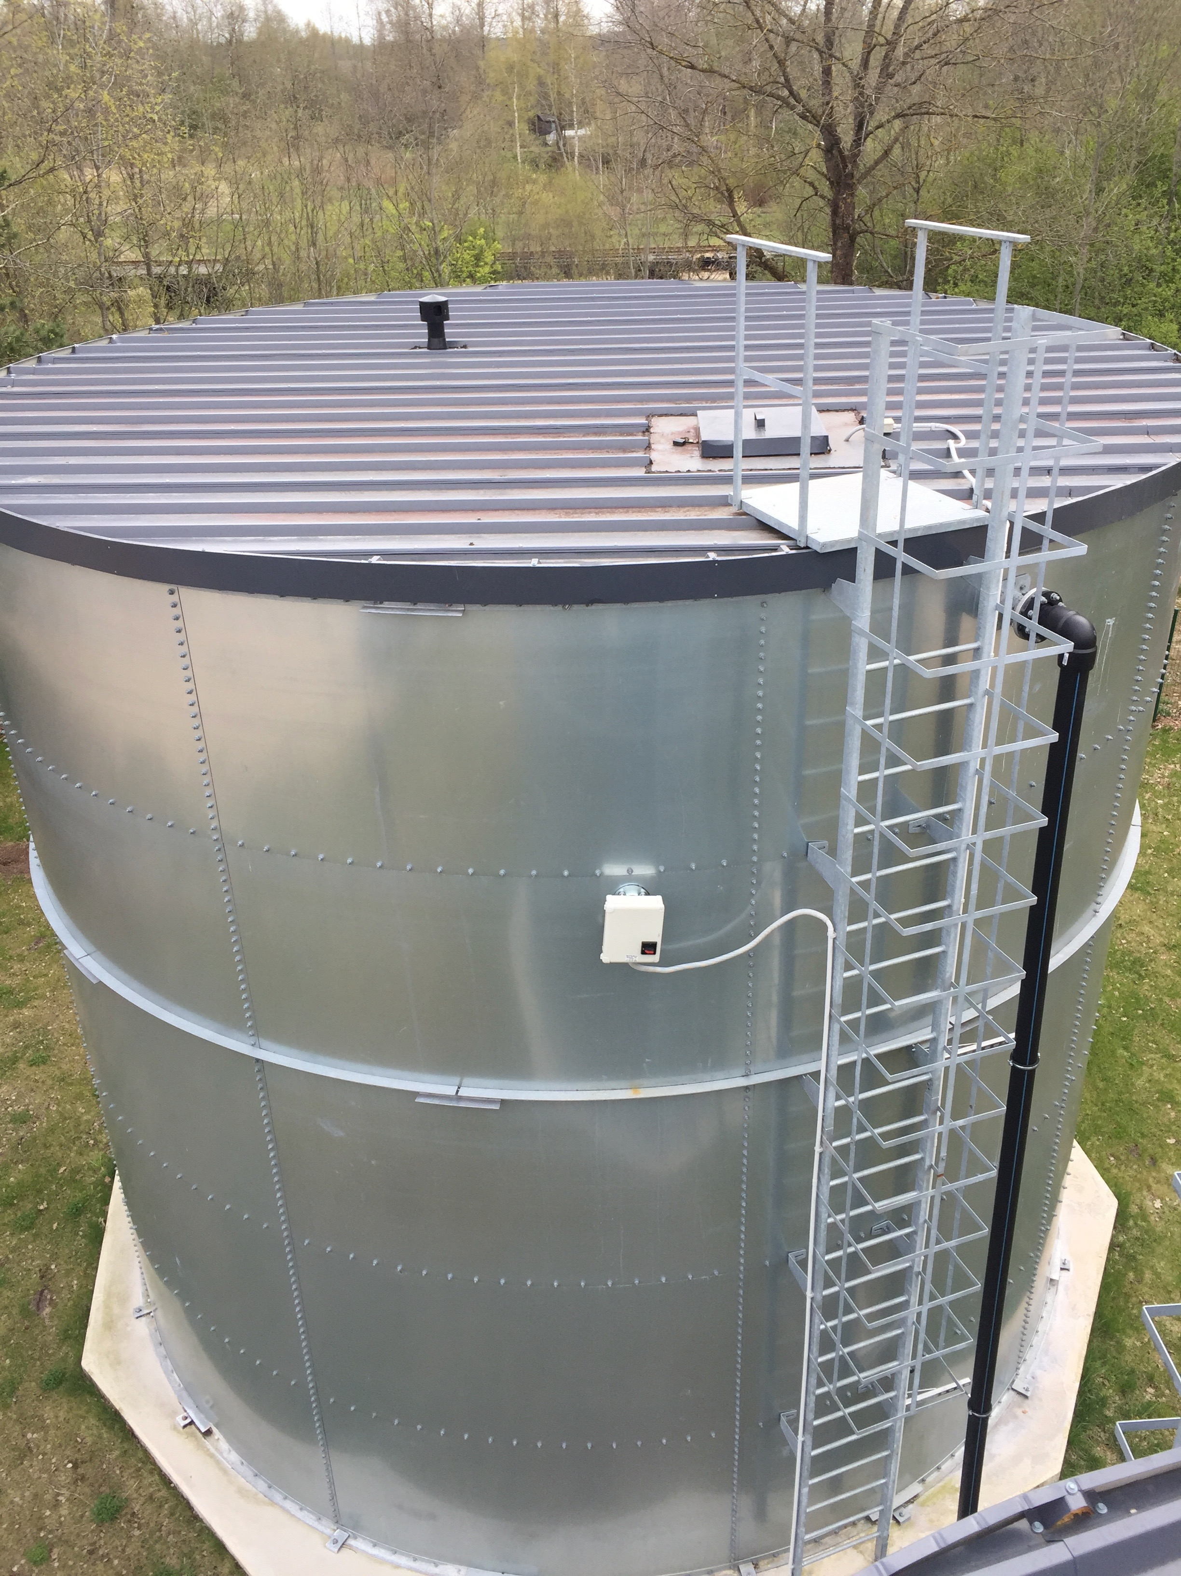
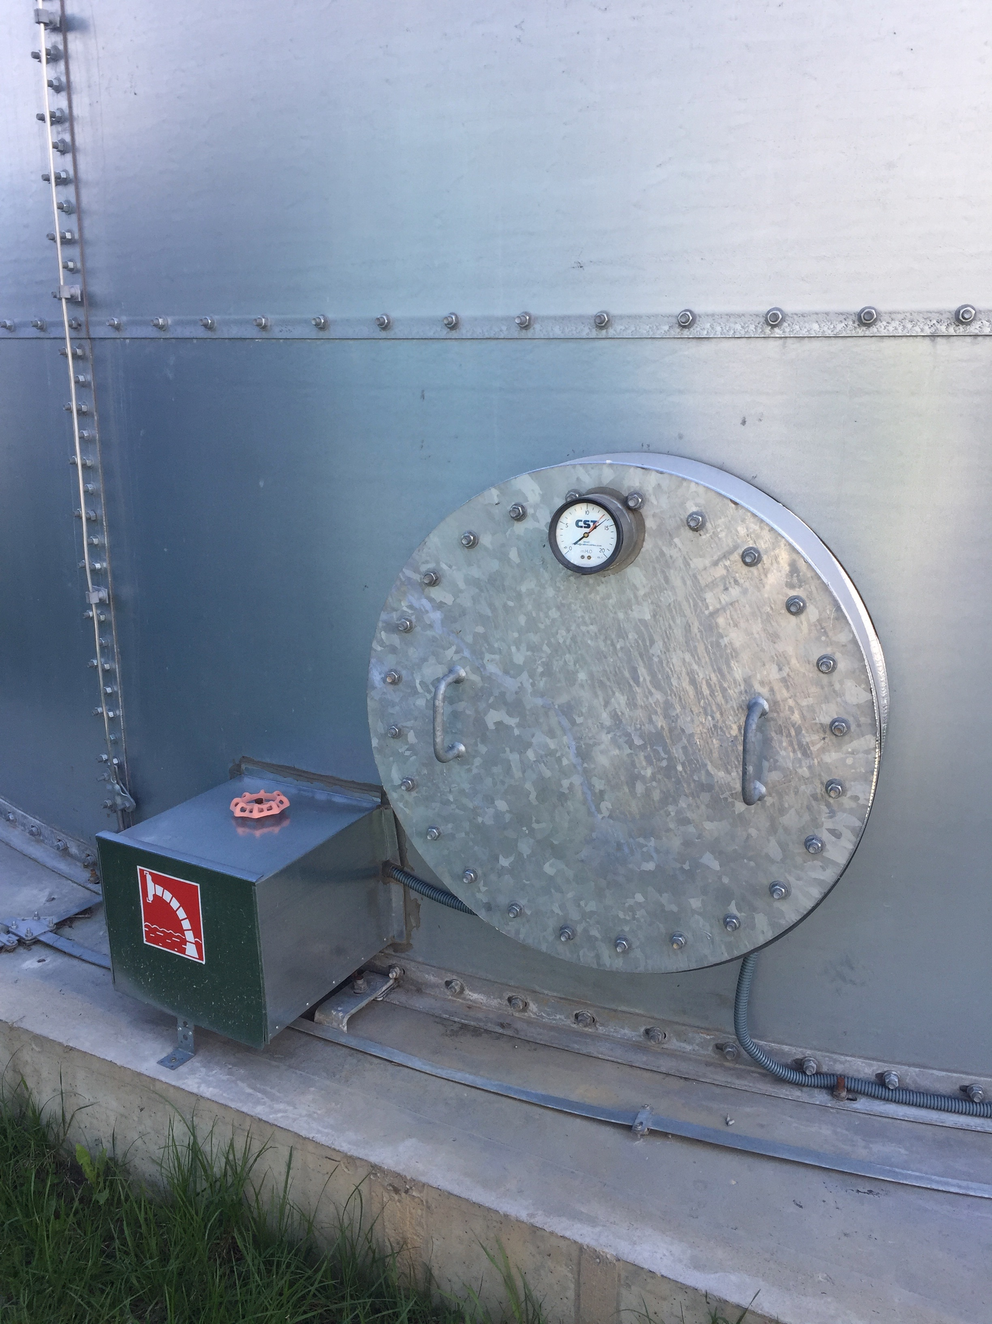
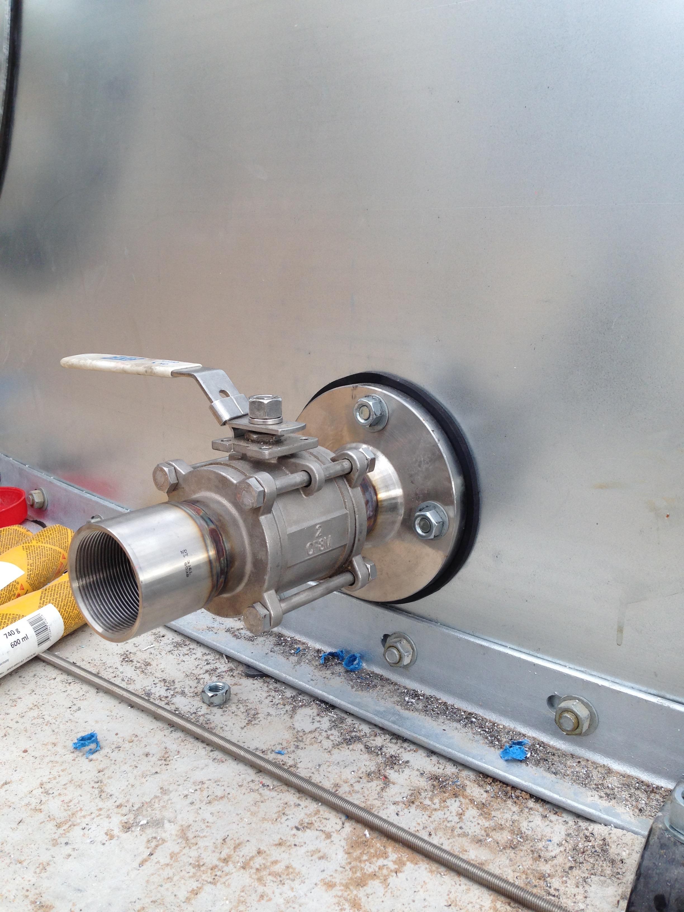
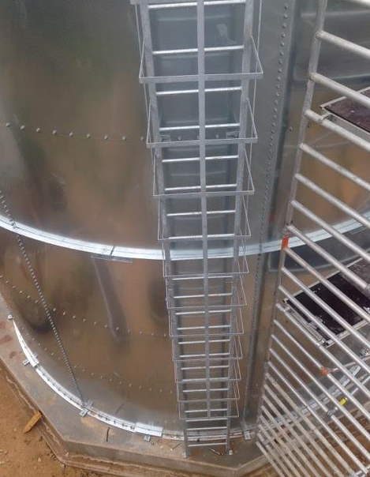
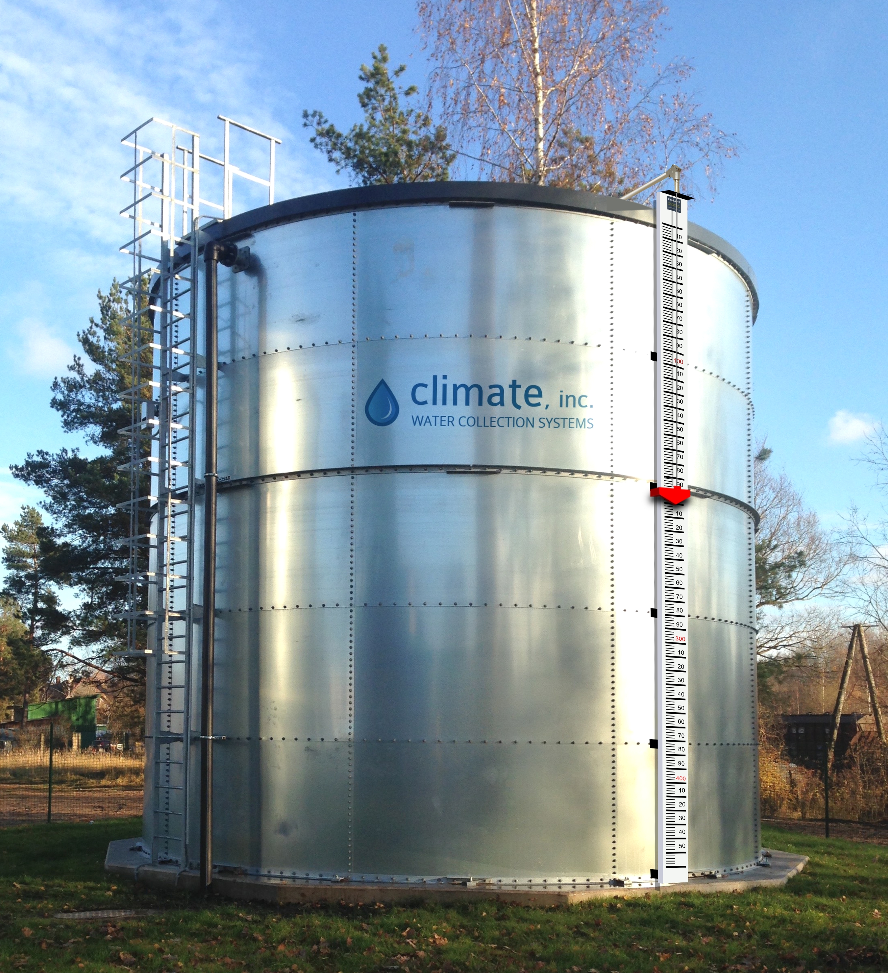
Climate fire suppression tank features:
Top Access
Hatch with 4” Curb
Side Access Hatch
Test Return & Flanges
Safety Cages and Ladders
Water Level
Indicator

Slide 8
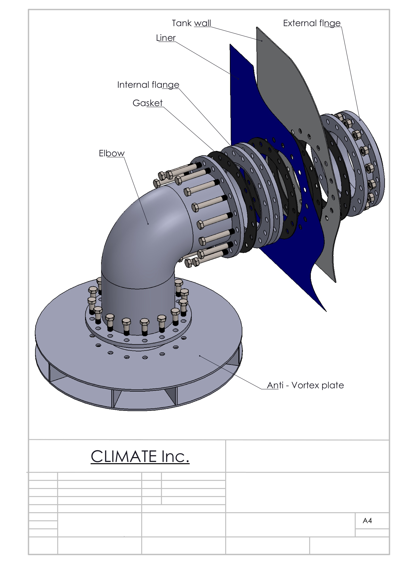
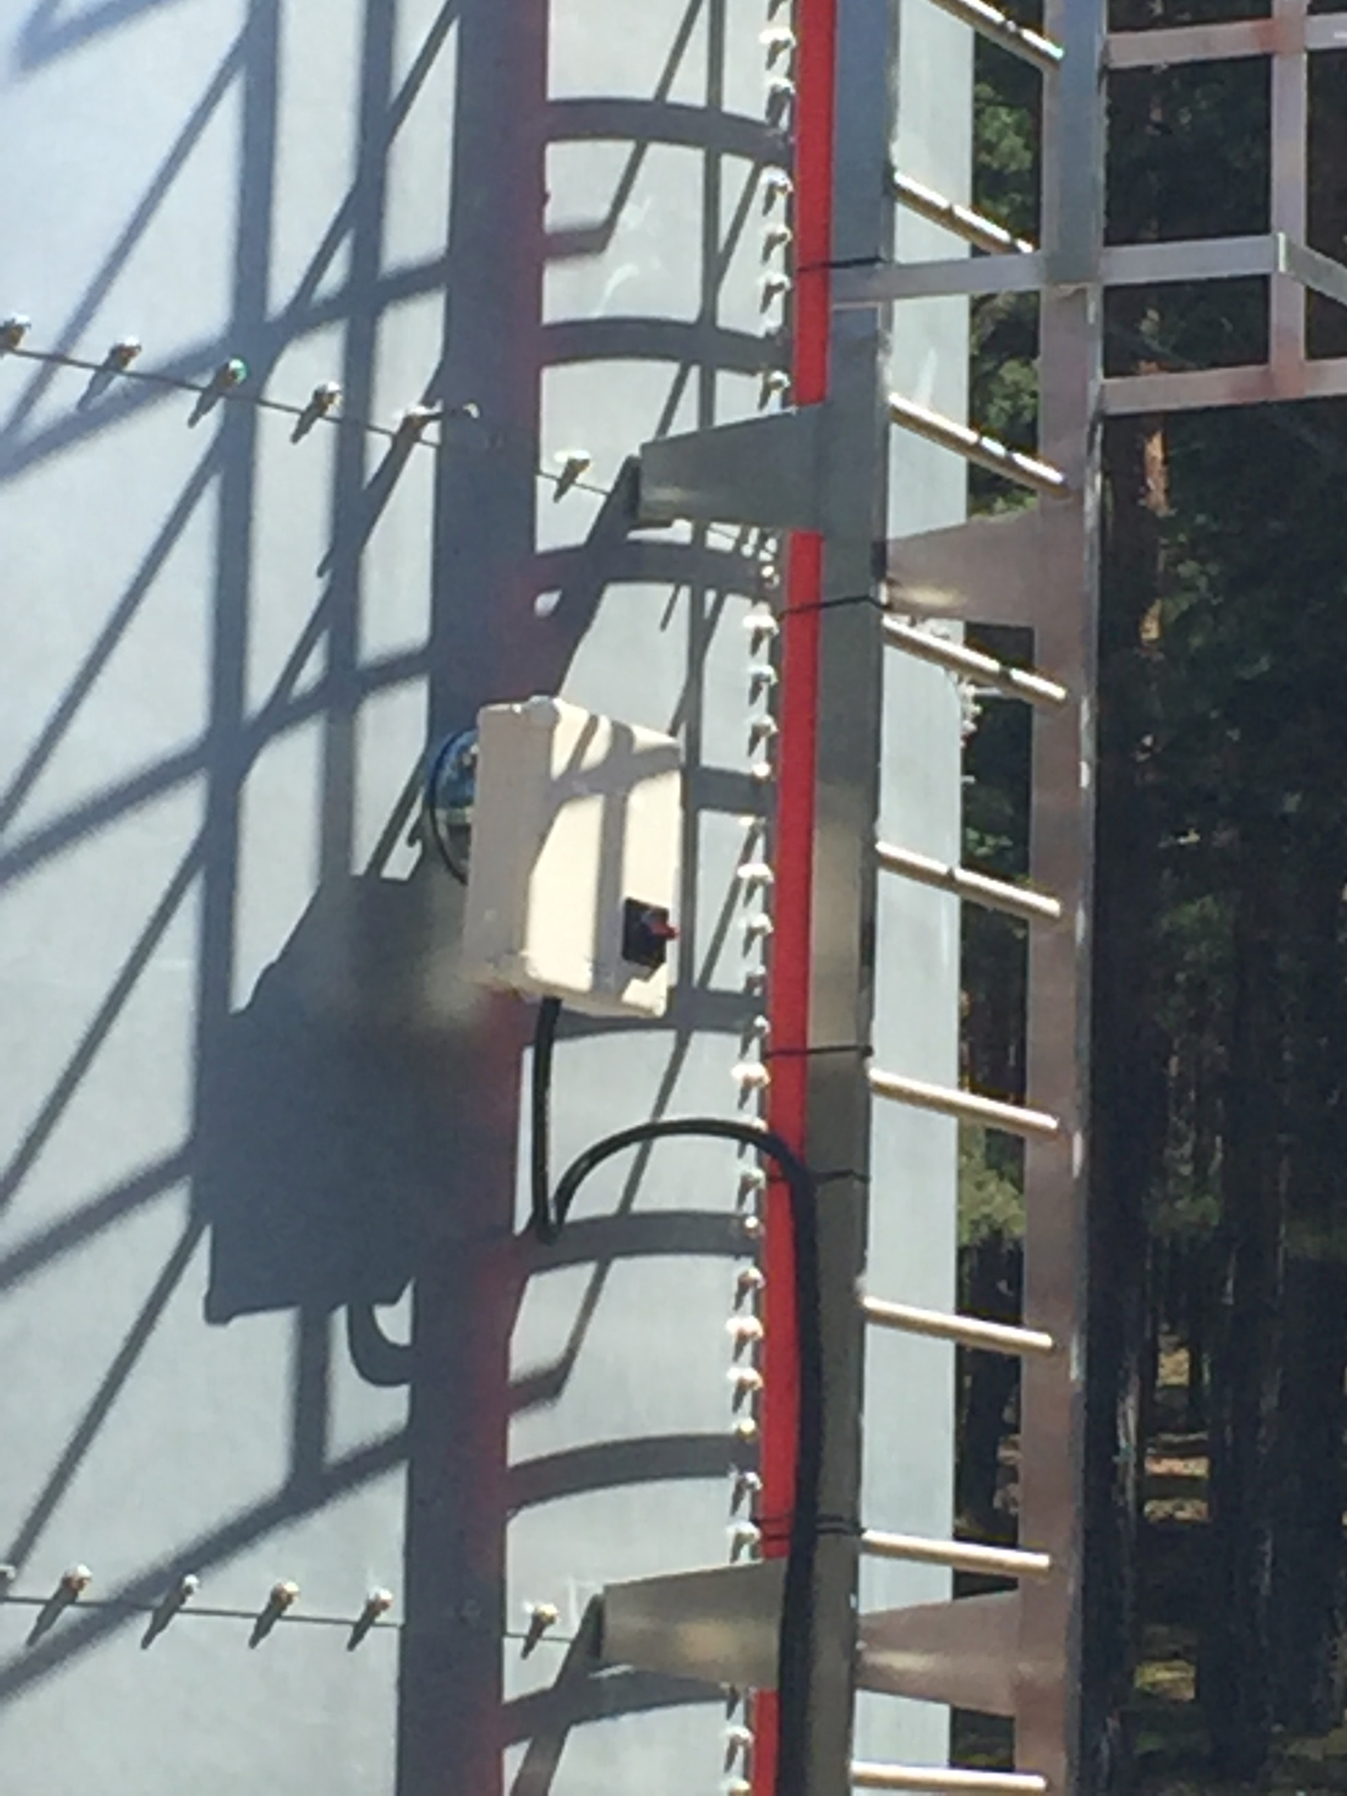
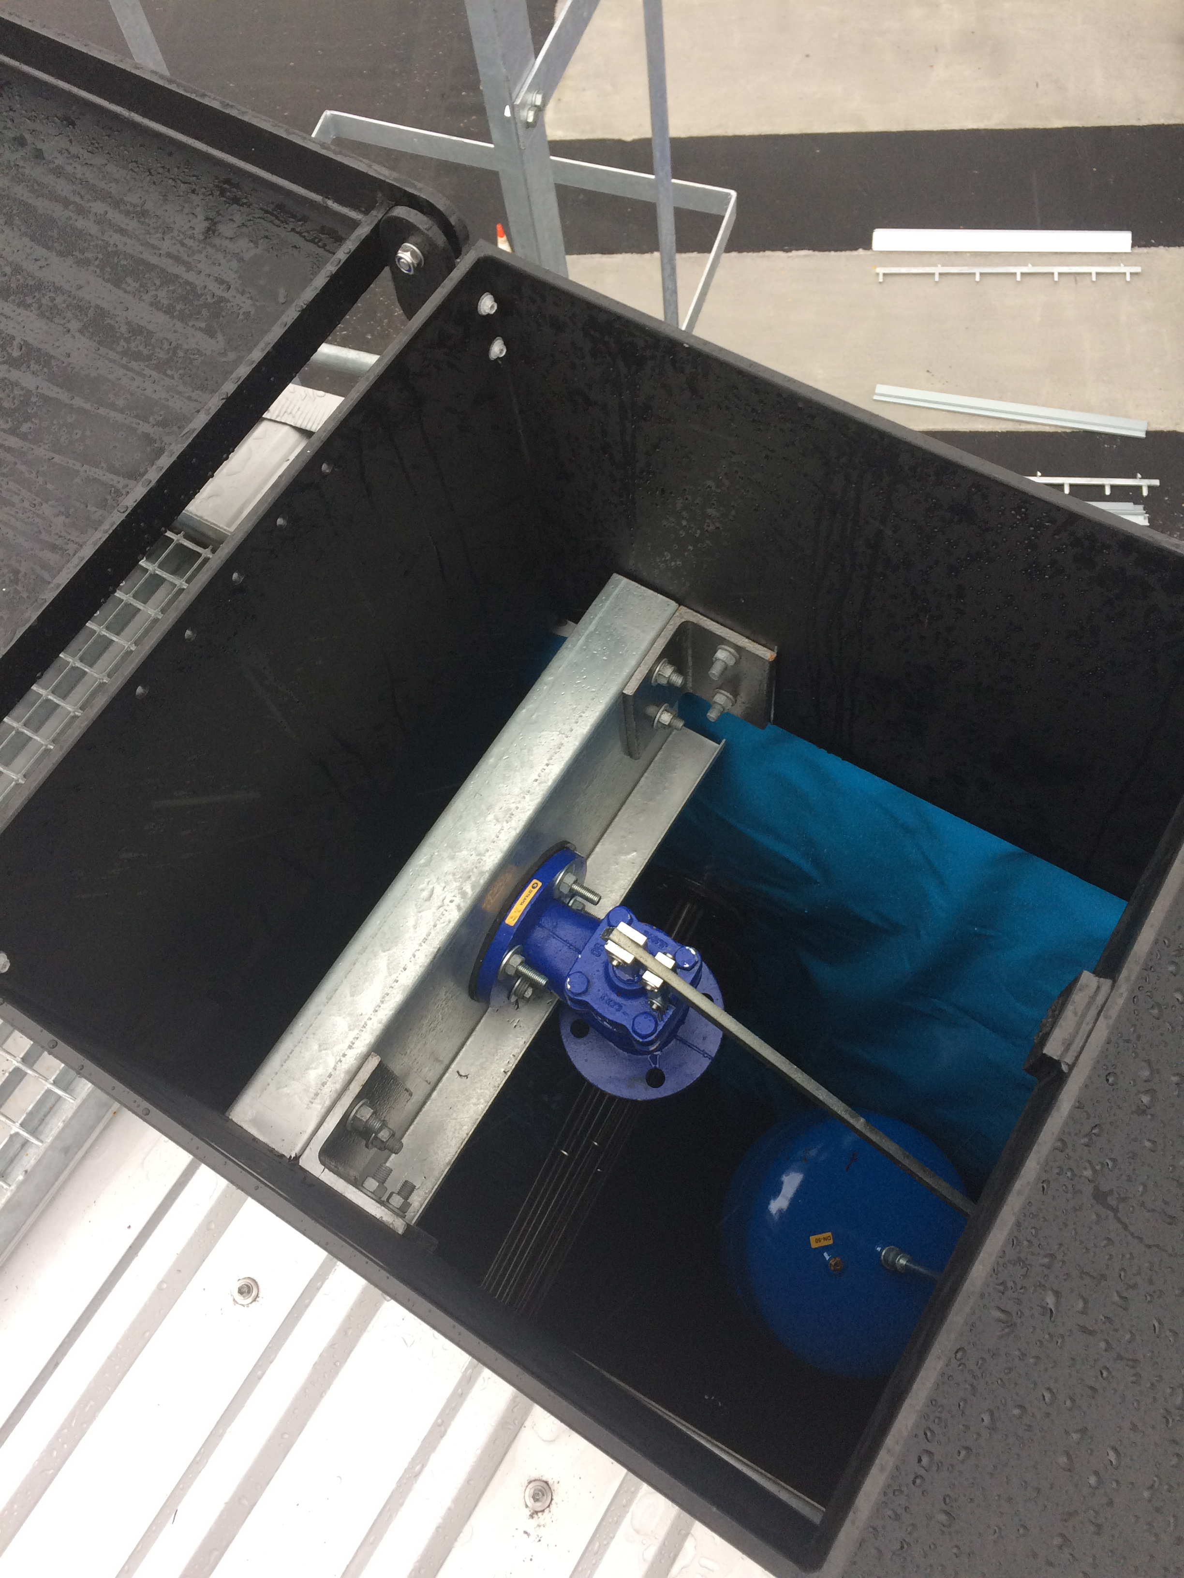
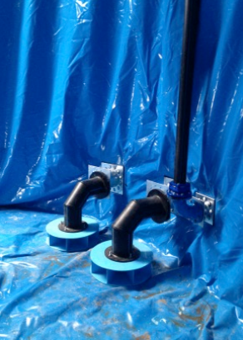
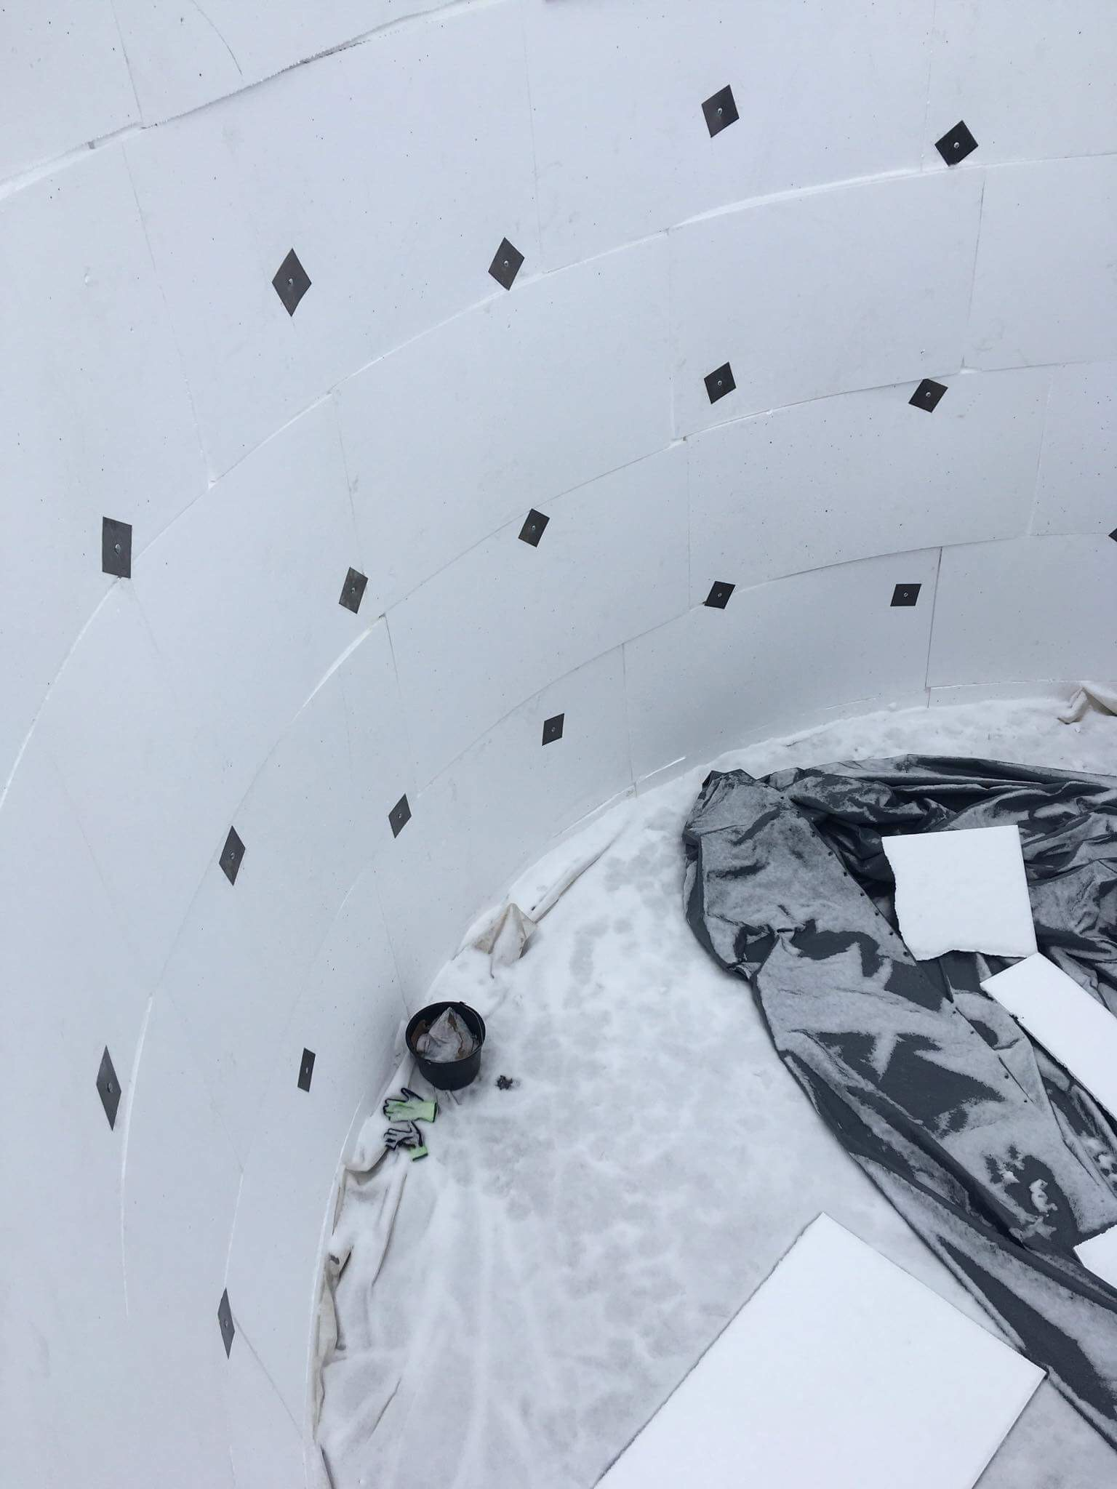
CLIMATE FIRE SUPPRESSION TANK FEATURES:
Insulation Package
Vortex Inhibitor
Inlet Valves & Float
Immersion Heater

Slide 9
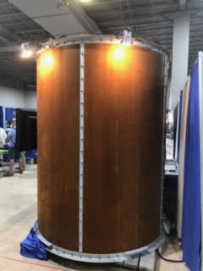
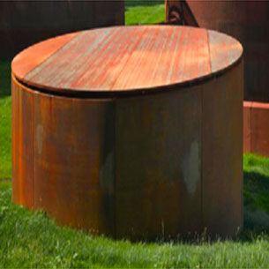
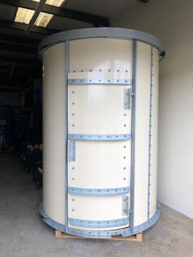
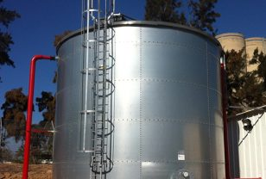
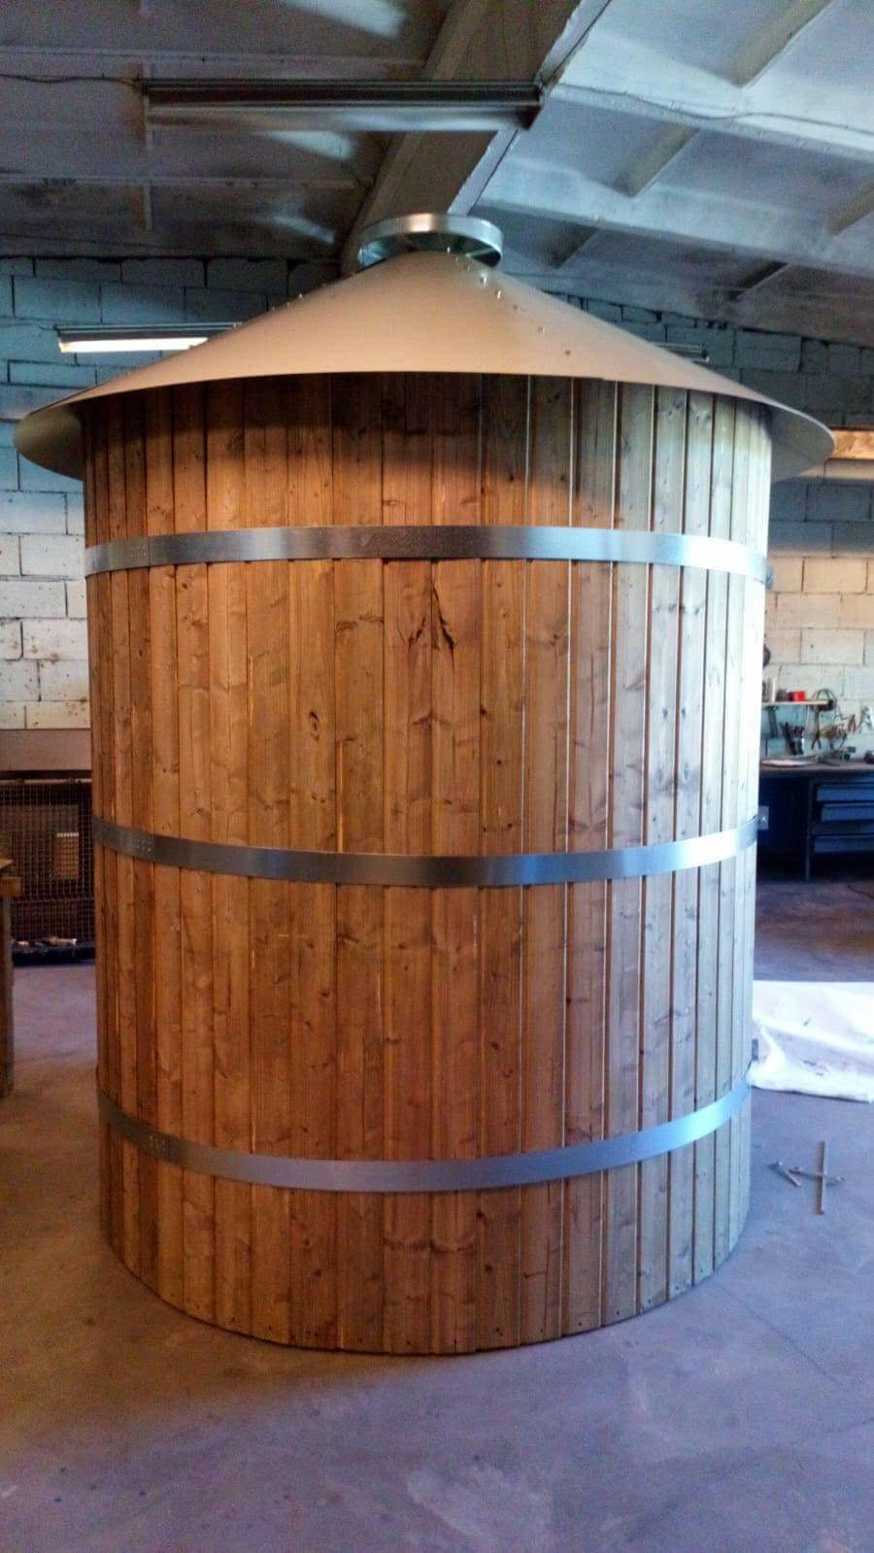
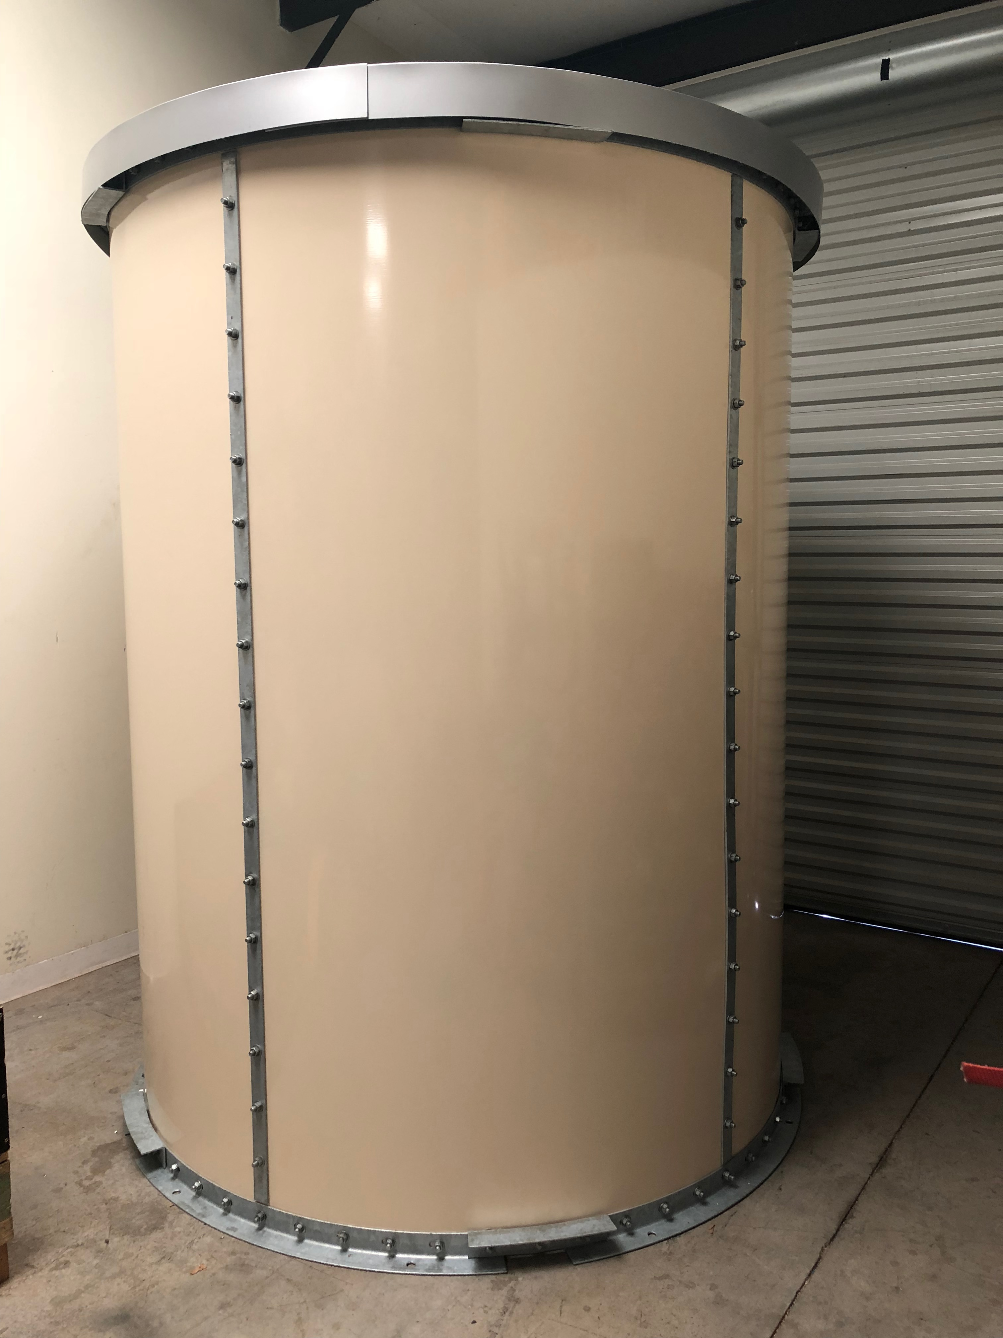
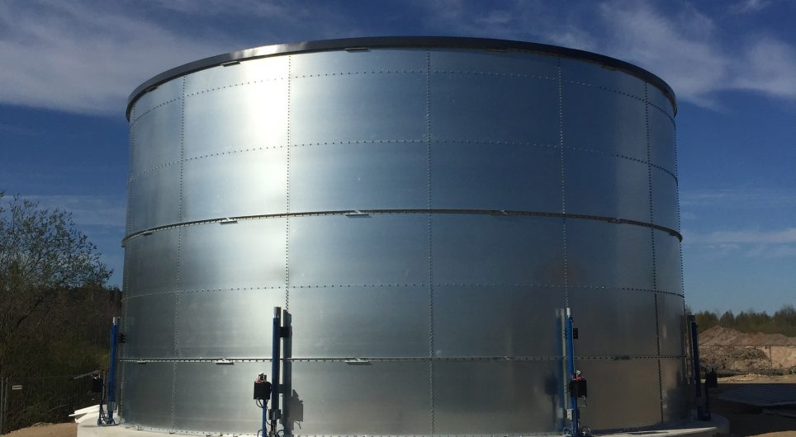
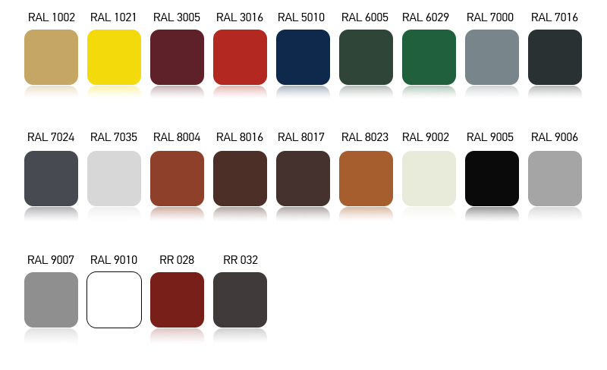
CLIMATE TANK COATINGS AND COLORS:
Climate Weathered Finish
Exterior Powder Coat Color Options
Wood Cladded
Glass Fused to Steel
or Epoxy Finished
What colors can I choose for the tank exterior?

Slide 10
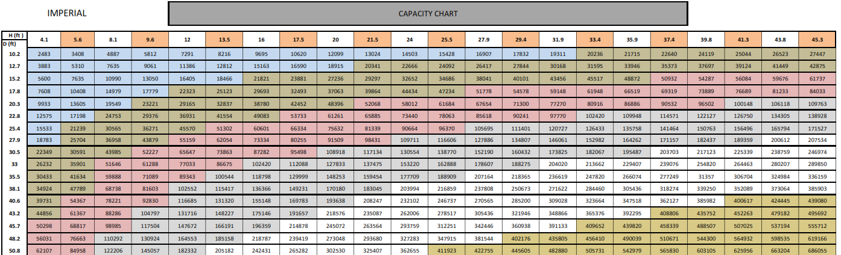
CLIMATE TANK SIZE CHART:

Slide 11
NEXT STEPS:
Design of fire suppression systems has three parts: determination of the water volume needed, the design of sprinkler distribution and the design of the storage and pumping system necessary for sprinkler operation. It is important to note that the final design will need the approval of the authority having jurisdiction before construction begins. This may be the local building inspector, fire chief, insurance underwriter, local or state code official, who may possibly modify the code requirements. So it is best to get their involvement early in the design process.

Slide 12
NEXT STEPS:
For a free consultation, please contact:
Eco-$mart, Inc
941-376-8484
info@eco-smart.com
Thank you for your interest

