Slide 2
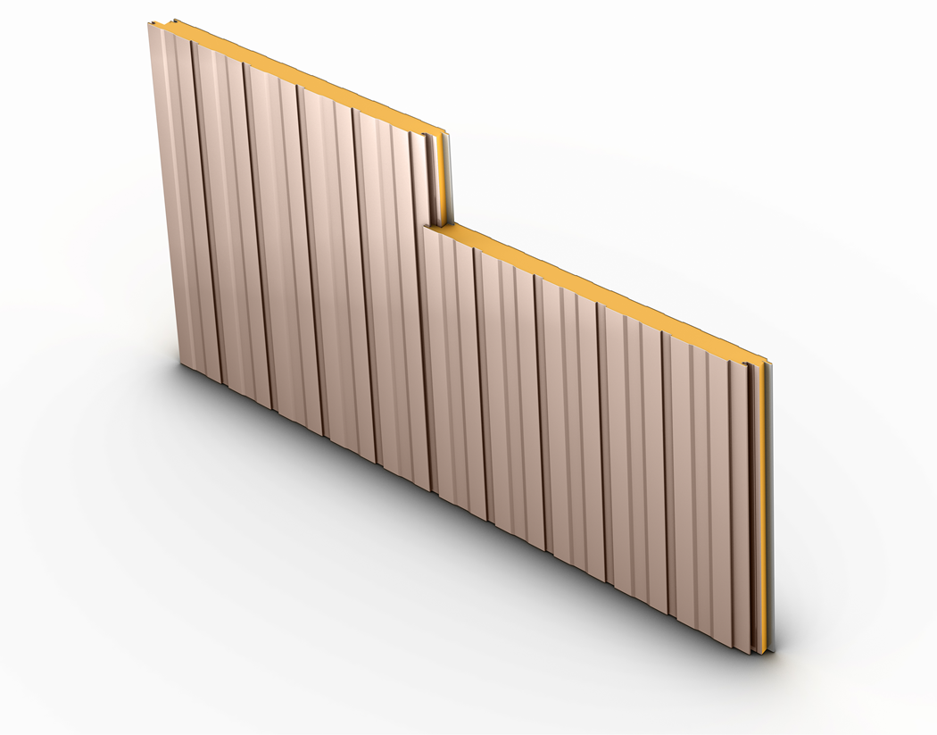
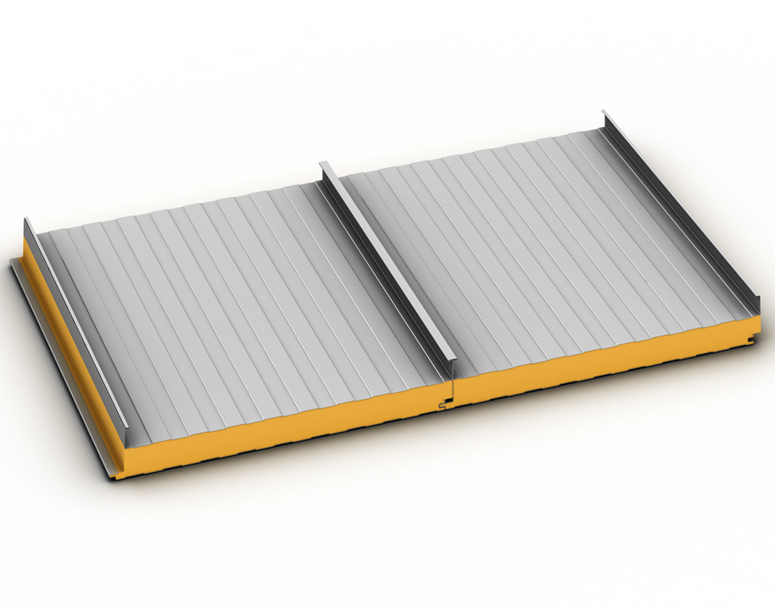
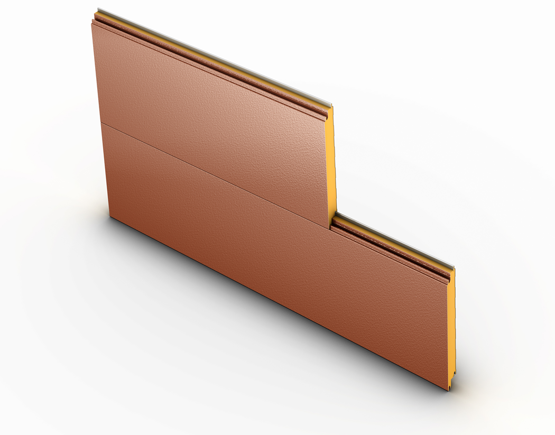
Isoleren
Insulated Metal Wall and Roof Panels
Isoleren
Insulated Metal Wall and Roof Panels

Slide 3
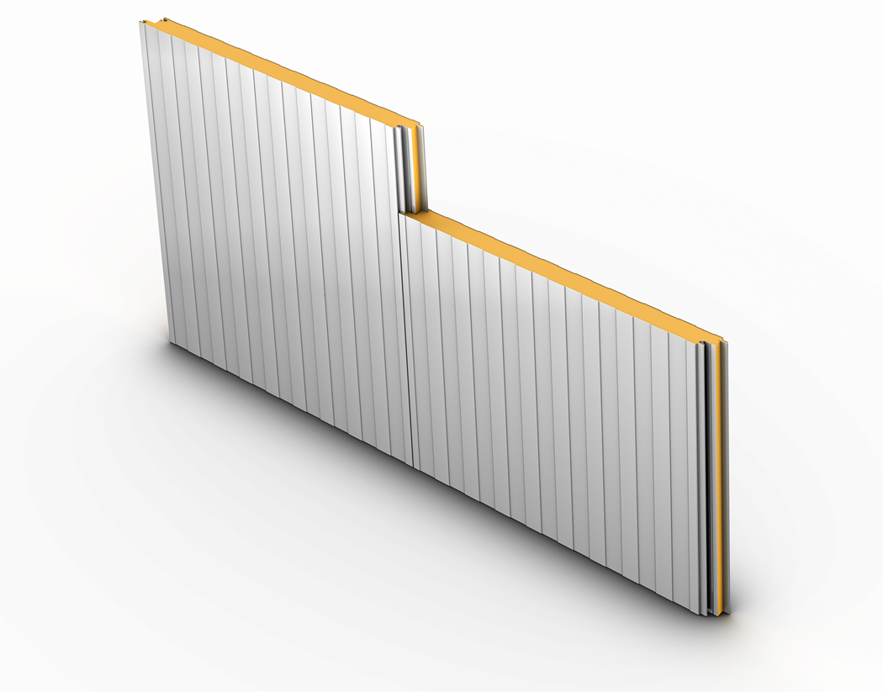
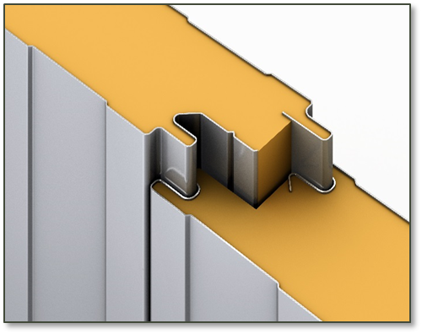
What are IMPs?
Insulated Metal Panels, or IMPs, are premier building products on the leading edge of innovation. The panels are formed by a continuously, foamed-in-place manufacturing process which binds interior and exterior single-skin steel panels to a polyisocyanurate foam core. With exceptional insulating values, architectural flexibility, ease of installation and green building properties, IMPs meet the needs of a variety of building projects.

Slide 4
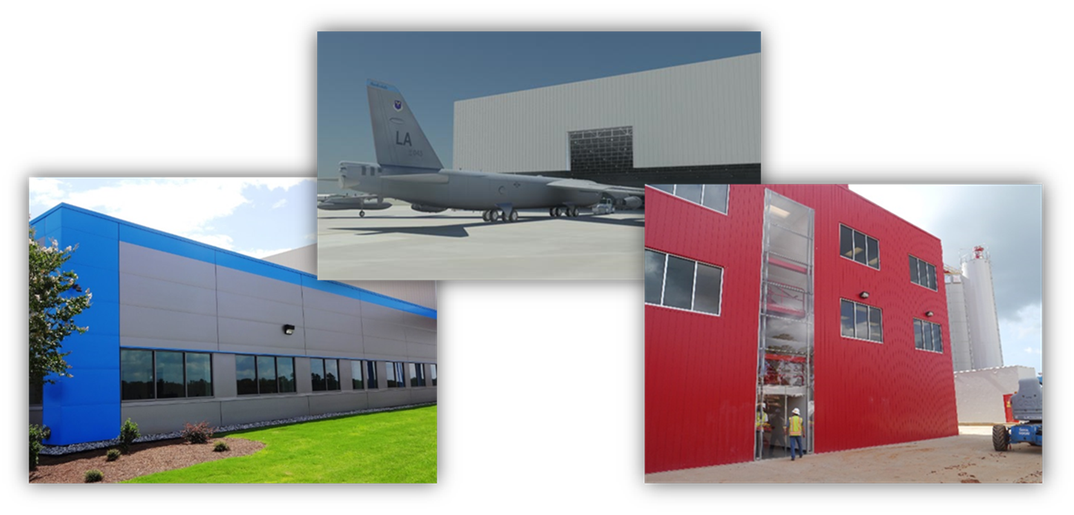
Applications
Applications of IMPs are extremely diverse and often include distribution warehouses, schools, universities, aircraft hangars, hospitals, public works buildings, office buildings, manufacturing facilities, cold storage sites, maintenance buildings, car dealerships, sports complexes, churches and residential applications.

Slide 5
Exterior Profiles
4 Lined - ML, SL, WL, VL (Interior Profile, ML)
Notes:
ML – lightly corrugated, ribbed, Mesa profile
SL – fluted, most dramatic profile (resembles reversed-rolled U-panel)
WL – striated, very small corrugated profile
VL – Micro-beads or pencil ribs

Slide 6
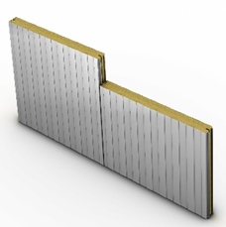
Exterior Profiles
3 Textured - IM, ST, IN (Interior Profile, ML)
1 Roof - RL (Interior Profile, ML)
1 Specialty (Fire Rated) - MF, VF, SF (Interior Profile, ML)
Notes:
IM – flat, heavy embossed
ST – flat, embossed
IN – flat, smooth
RL – standing seam, lightly corrugated, ribbed, Mesa profile
Isoleren Fire Rated – Available in MF, VF, SF profiles

Slide 7
Product Information
Gauge - 26, 24, 22
Gauge based on profile, texture and performance requirements
Thickness - 2", 2.5", 3", 4", 5", 6"
2" to 3“ - commercial/industrial/institutional
4" to 6“ - cold storage
Width - 42", 36", 30“
Width based on vertical/horizontal application and profile
Length - 8' min, 53‘ max (12’ roof)
Length based on vertical/horizontal application and profile
Texture - smooth or embossed
Colors – 7 wall colors, 5 roof colors unique to Isoleren
Exterior - PVDF, Interior: Polyester
Metal - Steel
Core - Continuously poured-in-place, polyisocyanurate, insulating foam

Slide 8
Product Information
Uncoiler section
Roll formers – liner/facer
Foaming section
Curing oven
Band saw
Stacking/staging area
Packing/shrink wrapping

Slide 9
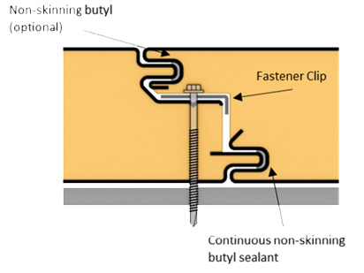
Installation
Single component wall assembly
Faster installs, fewer fasteners, fewer structural supports, all weather conditions except high winds
Vapor and Air Infiltration
Properly sealed system required
Non-skinning butyls used on perimeter and all joints
Creates air/vapor barrier
Drainage wall assembly
Single component assembly for use with exterior single skin facade
Trim and accessories available
Non-skinning butyl
(optional)
Continuous non-skinning
butyl sealant

Slide 10
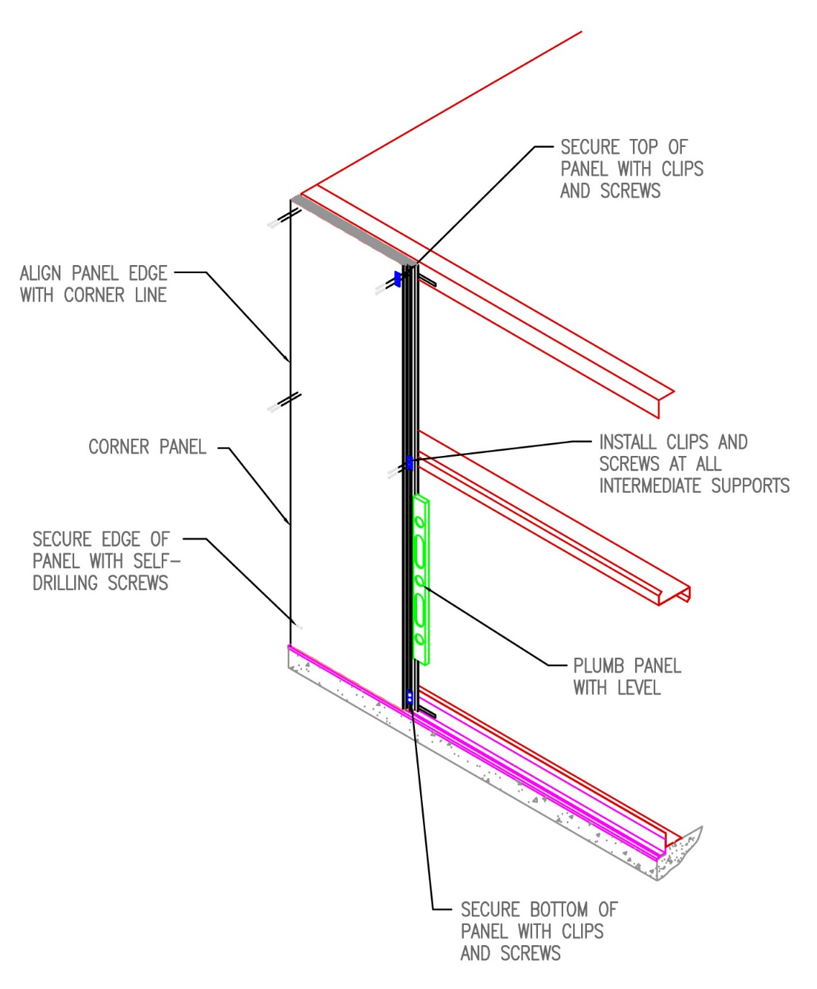
Installation
Secure top of panel with clips and screws
Align panel edge with corner line
Corner panel
Install clips and screws at all intermediate supports
Secure edge of panel with self-drilling screws
Plumb panel with level
Secure bottom of panel with clips and screws

Slide 11
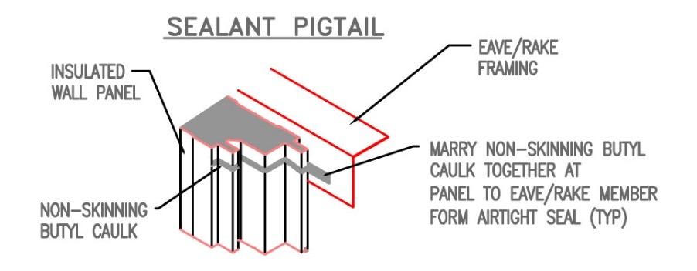
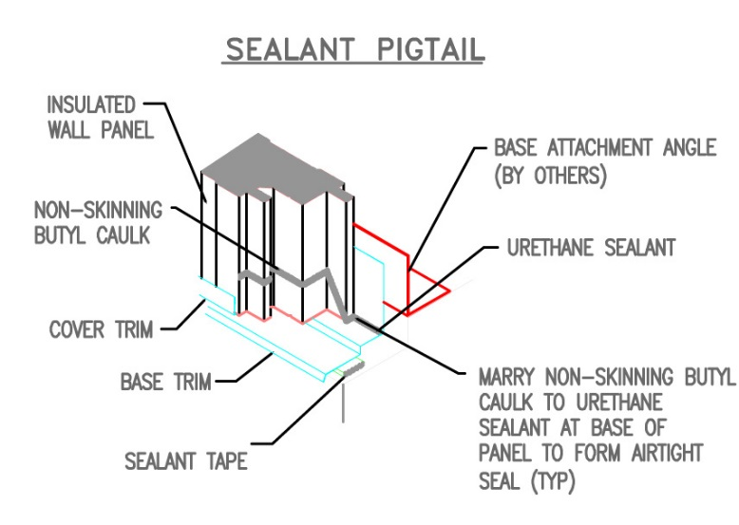
Installation
SEALANT PIGTAIL
Eave/Rake framing
Insulated wall panel
Marry non-skinning butyl caulk together at panel to eave/rake member form airtight seal
Non-skinning butyl caulk
SEALANT PIGTAIL
Insulated wall panel
Base attachment angle (by others)
Non-skinning butyl caulk
Urethane sealant
Cover trim
Base trim
Marry non-skinning butyl caulk to urethane sealant at base of panel to form airtight seal
Sealant tape

Slide 12
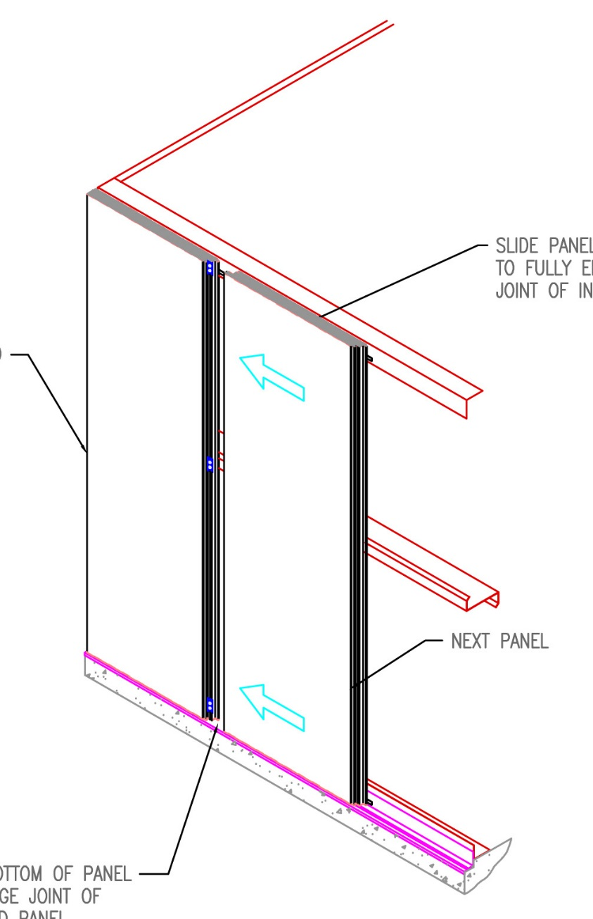
Installation
Slide panel over to fully engage joint of installed panel
Installed panel
Next panel
Push bottom of panel to engage joint of installed panel

Slide 13
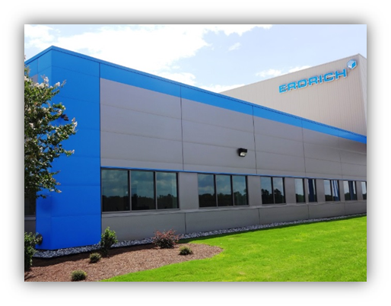
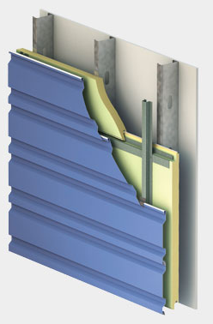
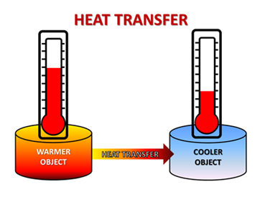
Performance
Single component wall assembly
Faster installs, fewer fasteners, fewer structural supports, all weather conditions except high winds, superior spanning
Exceptional insulating properties
R7.25 (thermal resistance) per inch
Sustainable
Reduces energy consumption, metal is recycled and recyclable
High quality
Structural, finished interior, rigorously tested, PVDF paint finishes, warranties
Architectural flexibility
Lightweight, thermally efficient
Dual uses: Primary wall component or drainage wall assembly
Can be integrated with traditional building systems
Various finishes, gauges, profiles and thicknesses

Slide 14
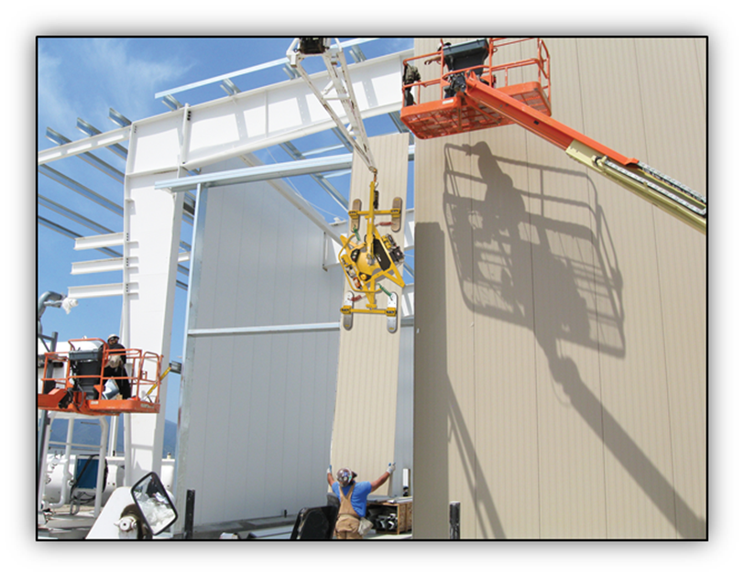
Resources
Support /Resources
Product data sheets
Color chart
Details/Drawings
Product specifications
Installation manuals
Testing
Technical bulletins
Warranty: panel warranty, paint warranty
2 year blister warranty
20 year substrate warranty
30 year finish warranty, 20 year product warranty
7 wall colors, 5 roof colors unique to Isoleren
Custom colors available and are subject to longer lead times & minimum quantity requirements

